Slide 2





Slide 4
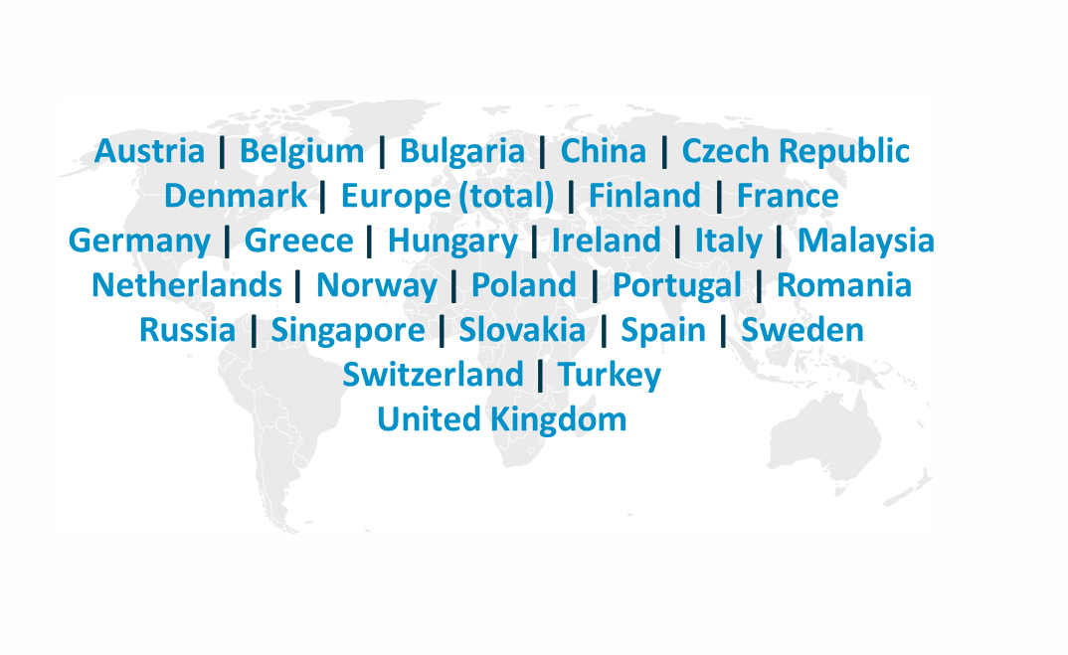

trendence radius of action
over 530,000 participants
27 countries
1,150 universities
Notes:
4

Slide 5





















































































trendence – clients (selection)
Notes:
-These are the household names we have worked with globally in the last 12 years.

Slide 15



Slide 90

Ditte Lorenz
Research Analyst
ditte.lorenz@trendence.com
+49 30 2592988 603
trendence Institut GmbH
Markgrafenstrasse 62
10969 Berlin
Notes:
90

