Slide 1

trendence Graduate Barometer 2011 - Business Edition
Partner report prepared for
Пловдивски университет „Паисий Хилендарски"

Slide 2

Contents
General information / methodology
Education and university evaluation
Career
Focus on Top Employers 2011
Profile

Slide 3
Methodology: trendence Graduate Barometer - European Edition
Global Information
Method: | Online-questionnaire
Field phase: | September 2010 to January 2011
Participation: Analysis: Student groups: Media coverage: | Invitations via careers service email; anonymity assured; prize draw & donation Data analysis with statistical tools; MRS and ESOMAR codes and ISO 20252 observed Europe sample and various sub-groups analyzed, including students from Bulgaria and Пловдивски университет „Паисий Хилендарски" FAZ 06/2011
Response
 | GBE 2009 | GBE 2010 | GBE 2011
Participating universities | 779 | 859 | 1,077
Respondents | 196,019 | 219,790 | 310,945

Slide 4
USPs
USPs of the trendence Graduate Barometer 2011:
The trendence Graduate Barometer has grown to be the largest survey on career, education and employer topics in Europe. 1,077 institutions in 24 countries took part and 310,000 students answered the survey.
The survey was conducted in the following countries: Austria, Belgium, Bulgaria, Czech Republic, Denmark, Finland, France, Germany, Greece, Hungary, Ireland, Italy, the Netherlands, Norway, Poland, Portugal, Romania, Russia, Slovakia, Spain, Sweden, Switzerland, Turkey and the United Kingdom.
The students were asked about their preferences and expectations in their future career, their satisfaction with their university, and the attractiveness of future employers.
The main target group for the survey was business/economics and engineering/IT/natural science students, however, we are of course interested in hearing the opinions of all students. Therefore we have three editions of the trendence Graduate Barometer Partner Report: business, engineering and total (including students of all fields of study).

Slide 5
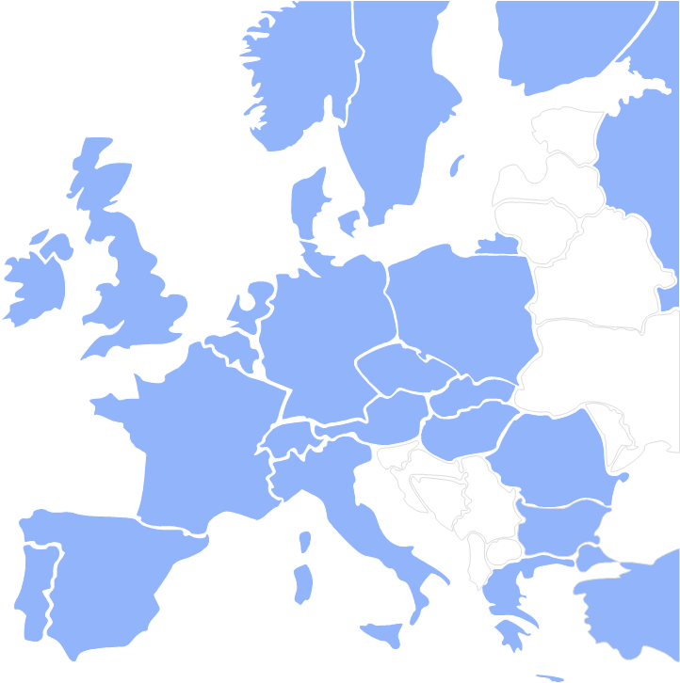
trendence Graduate Barometer 2011: participation

Slide 6
trendence Graduate Barometer 2011: participation (cont.)

Slide 7

Contents
General information / methodology
Education and university evaluation
Career
Focus on Top Employers 2011
Profile

Slide 8
Evaluation of university performance in Europe
Question: How does your university perform on these factors?

Slide 9
Evaluation of university performance in Europe (cont.)
Question: How does your university perform on these factors?

Slide 10
Important factors when choosing a university course
Question: Which are the most important factors for you when choosing a university / university course?

Slide 11
Important factors when choosing a university course (cont.)
Question: Which are the most important factors for you when choosing a university / university course?

Slide 12
Evaluation of university performance
Question: How does your university perform on these factors?

Slide 13
Evaluation of university performance (cont.)
Question: How does your university perform on these factors?

Slide 14
Opinion
My university course provides me with the skills necessary for the labour market.
Question: Please give your opinion on the following statement.

Slide 15
Use of university careers fair
Question: Have you attended / do you plan to attend this career fair?

Slide 16
Interest in studying a master course abroad
Question: Are you interested in studying a master degree in a foreign country?

Slide 17
Interest in studying a master course abroad (cont.)
Question: Are you interested in studying a master degree in a foreign country?

Slide 18
Desired master course destination
Question: Where would you like to study this master degree?

Slide 19
Desired master course destination (cont.)
Question: Where would you like to study this master degree?

Slide 20
Students wanting to study a master course in Bulgaria
Question: Where would you like to study this master degree?
This question has not been asked in Germany.

Slide 21

Contents
General information / methodology
Education and university evaluation
Career
Focus on Top Employers 2011
Profile

Slide 22
Opinion
I am worried about my future career
Question: Please give your opinion on the following statement.

Slide 23
Optimism indicator
Europe
Bulgaria
Пловдивски университет „Паисий Хилендарски"
Question: How many APPLICATIONS do you expect to send (did you send) to find your first professional position?
Question: How many MONTHS do you expect to need (did you require) to find your first professional position?
The trendence Optimism Index is an indicator for graduate confidence in relation to their job prospects. It has been calculated from two parameters, which have been chosen yearly as part of the evaluation of the job application process. 1) Number of anticipated applications. 2) Length of time it takes to get a job. The highest possible mark of 100 symbolises an "overheating" of the market: in such a market every graduate would find a position within the shortest of time and with minimal effort.

Slide 24
Career priorities
Question: What is important for your first professional position after graduation?

Slide 25
Job application process
Estimated timeframe to find first position
Question: How many MONTHS do you expect to need (did you require) to find your first professional position?

Slide 26
Job application process
Estimated timeframe to find first position (cont.)
Question: How many MONTHS do you expect to need (did you require) to find your first professional position?

Slide 27
Job application process
Estimated number of applications to find first position
Question: How many APPLICATIONS do you expect to send (did you send) to find your first professional position?

Slide 28
Job application process
Estimated number of applications to find first position (cont.)
Question: How many APPLICATIONS do you expect to send (did you send) to find your first professional position?

Slide 29
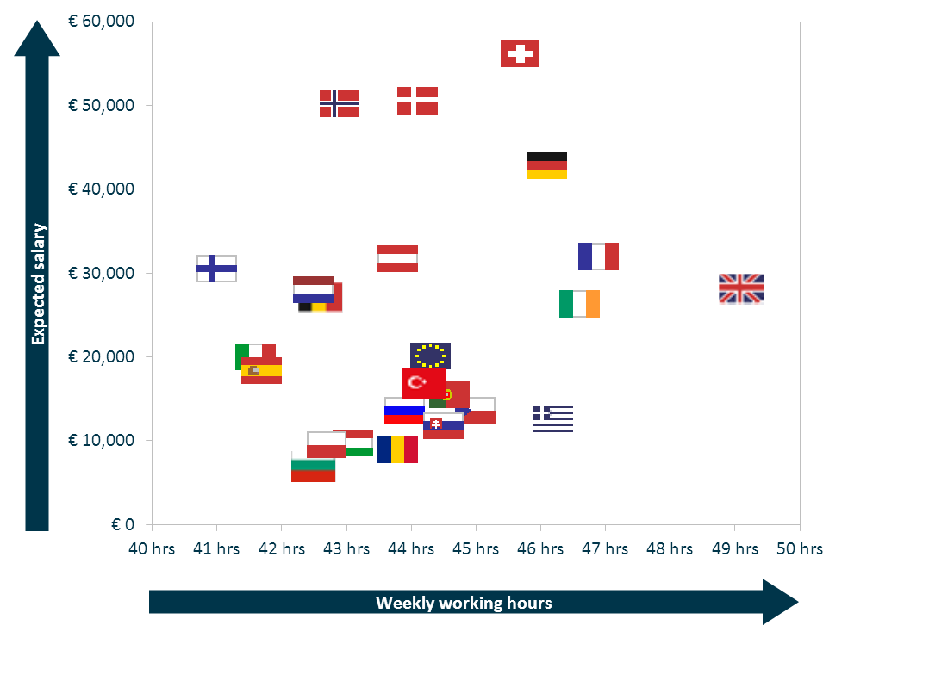
Expectations of first position
Expected gross annual salary / expected working hours relationship in Europe
Question: How much do you expect to earn per year (gross income, including bonus) in your first professional position after graduation?
Question: How many hours are you prepared to work per week in your first professional position after graduation?

Slide 30
Expectations of first position
Expected gross annual salary
Question: How much do you expect to earn per year (gross income, including bonus) in your first professional position after graduation?

Slide 31
Expectations of first position
Expected gross annual salary (cont.)
Question: How much do you expect to earn per year (gross income, including bonus) in your first professional position after graduation?

Slide 32
Expectations of first position
Expected working hours
Question: How many hours are you prepared to work per week in your first professional position after graduation?

Slide 33
Expectations of first position
Expected working hours (cont.)
Question: How many hours are you prepared to work per week in your first professional position after graduation?

Slide 34
Expectations of first position
Expected time in first position
Question: How many years do you plan to work in your first professional position after graduation?

Slide 35
Expectations of first position
Expected time in first position (cont.)
Question: How many years do you plan to work in your first professional position after graduation?

Slide 36
Opinion
After graduating I will leave my country to find a professional position abroad
Question: Please give your opinion on the following statement.

Slide 37
Mobility – willingness to relocate
Question: Imagine you received an attractive job offer. To what extent would you relocate?

Slide 38
Mobility – willingness to relocate (cont.)
Question: Imagine you received an attractive job offer. To what extent would you relocate?

Slide 39
Mobility – emigration destination
Question: Which foreign countries would you be most likely to move to for your first professional position after graduation?

Slide 40
Mobility – emigration destination (cont.)
Question: Which foreign countries would you be most likely to move to for your first professional position after graduation?

Slide 41

Contents
General information / methodology
Education and university evaluation
Career
Focus on Top Employers 2011
Profile

Slide 42
Who are the most attractive employers in Europe?
Question: Which companies would you most likely apply to upon graduation?

Slide 43
Who are the most attractive employers in Bulgaria?
Question: Which companies would you most likely apply to upon graduation?

Slide 44
Who are the most attractive employers at your university?
Question: Which companies would you most likely apply to upon graduation?

Slide 45
Who are the most active employers in Bulgaria?
Question: Which 3 employers most actively target students at your university?

Slide 46
Who are the most active employers at your university?
Question: Which 3 employers most actively target students at your university?

Slide 47
General communication channels used
Question: Which of the following methods do you use most often to find out more about potential employers?

Slide 48
General communication channels used (cont.)
Question: Which of the following methods do you use most often to find out more about potential employers?

Slide 49
Most appealing campus marketing activities
Question: Which employer activities on campus appeal to you most?

Slide 50
Most appealing campus marketing activities (cont.)
Question: Which employer activities on campus appeal to you most?

Slide 51

Contents
General information / methodology
Education and university evaluation
Career
Focus on Top Employers 2011
Profile

Slide 52
Opinion
Students should pay for their tertiary education
Question: Please give your opinion on the following statement.

Slide 53
Profile
Age and gender
Question: How old are you?
Question: You are… (a man / a woman?)

Slide 54
Profile (cont.)
Subjects
Question: What main subjects do you study?

Slide 55
Profile (cont.)
Subjects (cont.)
Question: What main subjects do you study?

Slide 56
Profile (cont.)
Length of education
Question: When did you start studying your first course at university?
Question: When do you expect to start your first professional position after graduation?

Slide 57
Profile (cont.)
Academic achievement
Question: How would you describe your academic achievements?

Slide 58
Profile (cont.)
Academic achievement (cont.)
Question: How would you describe your academic achievements?

Slide 59
Profile (cont.)
Course type
Question: What type of course are you currently completing?

Slide 60
Profile (cont.)
Course type (cont.)
Question: What type of course are you currently completing?

Slide 61
Experiences and advanced english skills
Question: What experience s(of at least 3 months length) do you have?
Question: Do you speak English at a HIGHLY ADVANCED LEVEL? In this sense 'highly advanced level' means that you can speak, write and understand the language without any difficulties. I.e. You are fluent, have a large vocabulary and make very few grammatical errors.

Slide 62
Experiences and advanced english skills (cont.)
Question: What experience s(of at least 3 months length) do you have?
Question: Do you speak English at a HIGHLY ADVANCED LEVEL? In this sense 'highly advanced level' means that you can speak, write and understand the language without any difficulties. I.e. You are fluent, have a large vocabulary and make very few grammatical errors.

Slide 63
Advanced english skills in Europe
Question: Do you speak English at a HIGHLY ADVANCED LEVEL? In this sense 'highly advanced level' means that you can speak, write and understand the language without any difficulties. I.e. You are fluent, have a large vocabulary and make very few grammatical errors.

Slide 64
Advanced english skills in Europe (cont.)
Question: Do you speak English at a HIGHLY ADVANCED LEVEL? In this sense 'highly advanced level' means that you can speak, write and understand the language without any difficulties. I.e. You are fluent, have a large vocabulary and make very few grammatical errors.

Slide 65
For enquiries please contact:
Ulrike Heyne
Research Manager
Phone: +49 30 2592988-306
Fax: +49 30 2592988-901
Ulrike.Heyne@trendence.com
trendence Institut GmbH
Markgrafenstrasse 62
10969 Berlin, Germany
Notes:
65

