Slide 1

Development of methods for trace element determination in accordance with
GREEN chemistry principles
V. Kmetov, V. Stefanova, K. Simitchiev, D. Georgieva
Department of Analytical Chemistry and Computer Chemistry,
University of Plovdiv, Bulgaria
N.Kovachev, A. Canals
Department of Analytical Chemistry and Food Science,
University of Alicante, Spain
Notes:
Dear colleagues
Approaching to the to the last lecture of this session I’m going to speak about ….
I’m going to summarize the research that was done as a collaborative study between both groups – PU and Alicante,
The key players here – Dr. Stefanova, and our PhD student K. Simitchiev who can help me to answer to the difficult questions

Slide 2
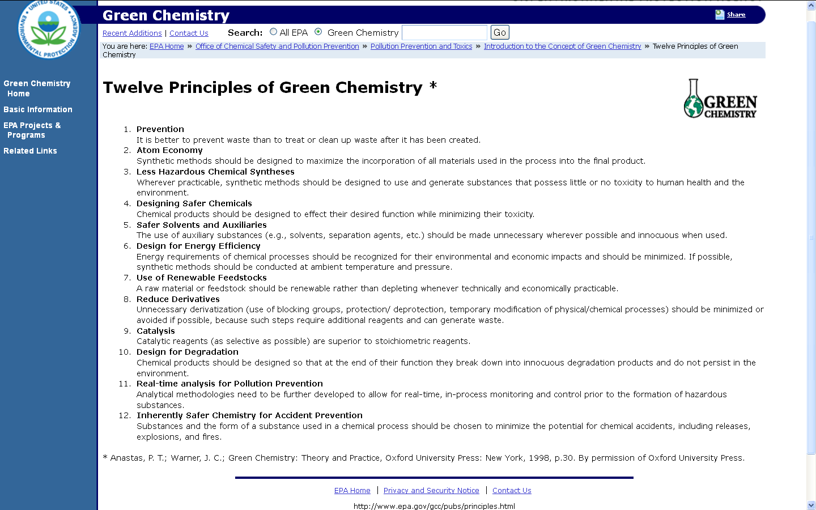
Prevention
Atom Economy
Less Hazardous
Chemical
Designing Safer
Chemicals
Safer Solvents
Energy
Efficiency
Renewable
Feedstocks
Reduce
Derivatives
Catalysis
Design for
Degradation
Real-time
analysis
Accident
Prevention

Slide 3
G A M A DO 02-70
Green Analytical Methods Academic Centre
MW
SPE
CPE
ASDI
MNPs
Prevention
Atom Economy
Less Hazardous
Chemical
Designing Safer
Chemicals
Safer Solvents
Energy
Efficiency
Renewable
Feedstocks
Reduce
Derivatives
PU
AU
SU
UFT
Catalysis
Design for
Degradation
UA
Real-time
analysis
Accident
Prevention

Slide 4
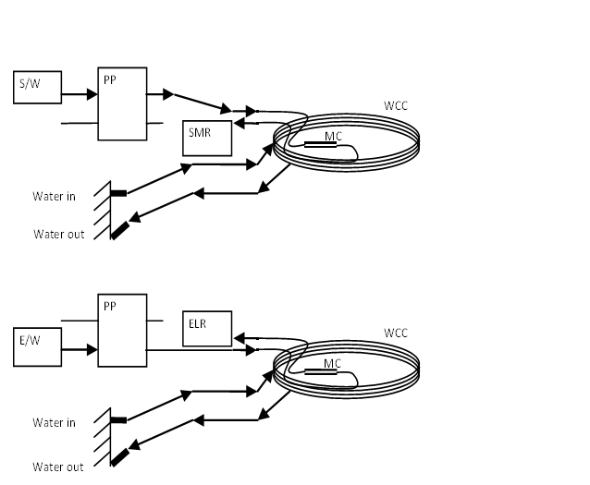
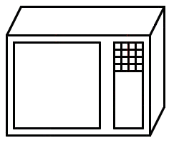
Microwave-assisted solid phase extraction of Pd and Pt for their ICP-MS determination
MW
SPE
CPE
ASDI
MNPs
Prevention
Atom Economy
Less Hazardous
Chemical
Designing Safer
Chemicals
sample in 1 M HCl
flow rate 3 ml min⁻¹
thioureido propyl functionalized silica gel 0.12 g packed microcolumn
1 ml eluent 0.5% thiourea flow rate
0.5 mL min-¹
MW 800W
Safer Solvents
Energy
Efficiency
adsorption stage
Renewable
Feedstocks
ICP-MS
Reduce
Derivatives
Catalysis
Design for
Degradation
desorption (elution) stage
Real-time
analysis
Sample preparation system: DMO – domestic microwave oven, WCC – water cooling circuit, MC – microcolumn, PP – peristaltic pump, S/W – sample or water,
E/W – eluent or water, SMR – separated matrix recipient, ELR – eluate recipient
Accident
Prevention
Notes:
ELAN DRC II
PM10 particulate mater samples smaller than 10 um in filter from 720 m3 of air
CRM – Medisafe – human serum

Slide 5
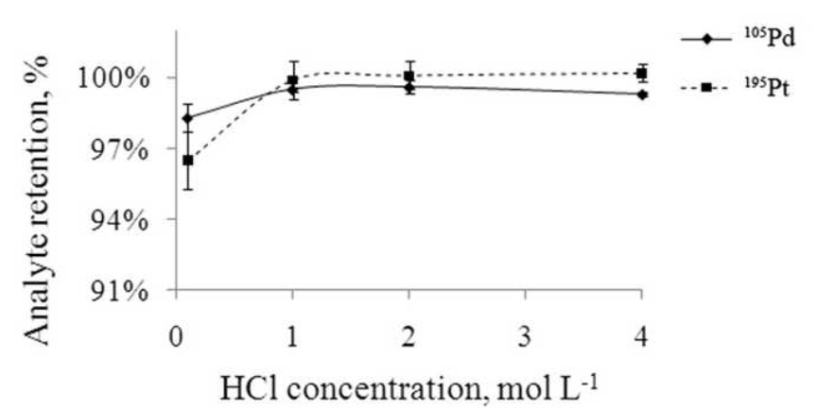
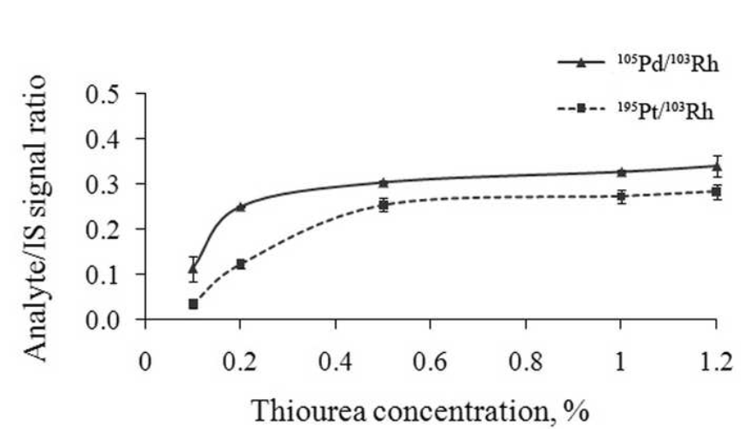
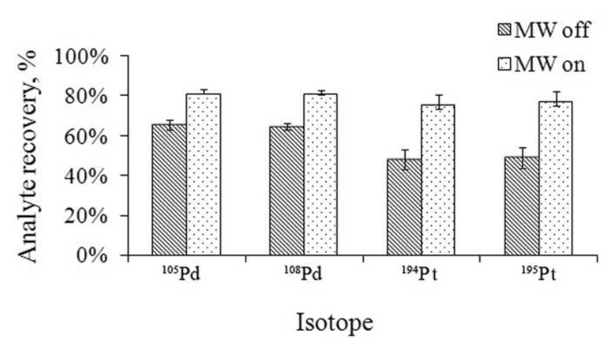
Microwave-assisted solid phase extraction of Pd and Pt for their ICP-MS determination
MW
SPE
CPE
ASDI
MNPs
Prevention
Atom Economy
Less Hazardous
Chemical
Designing Safer
Chemicals
Safer Solvents
Energy
Efficiency
Renewable
Feedstocks
Reduce
Derivatives
Catalysis
Design for
Degradation
Real-time
analysis
Accident
Prevention
Notes:
ELAN DRC II
PM10 particulate mater samples smaller than 10 um in filter from 720 m3 of air
CRM – Medisafe – human serum

Slide 6
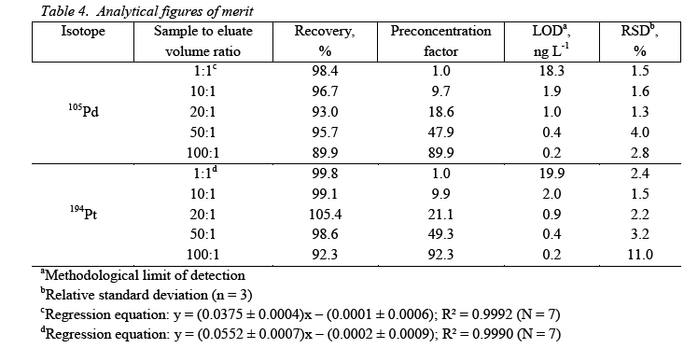
Microwave-assisted solid phase extraction of Pd and Pt for their ICP-MS determination
MW
SPE
CPE
ASDI
MNPs
Prevention
Atom Economy
Less Hazardous
Chemical
Designing Safer
Chemicals
Safer Solvents
Energy
Efficiency
Renewable
Feedstocks
Reduce
Derivatives
Catalysis
Design for
Degradation
Real-time
analysis
Accident
Prevention
Notes:
ELAN DRC II
PM10 particulate mater samples smaller than 10 um in filter from 720 m3 of air
CRM – Medisafe – human serum

Slide 7
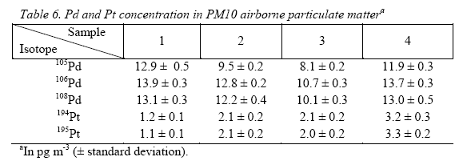
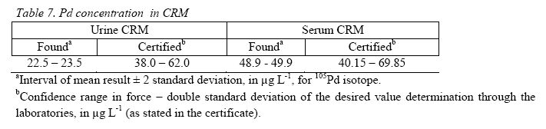
Microwave-assisted solid phase extraction of Pd and Pt for their ICP-MS determination
MW
SPE
CPE
ASDI
MNPs
Prevention
Atom Economy
Less Hazardous
Chemical
Designing Safer
Chemicals
Safer Solvents
Energy
Efficiency
Renewable
Feedstocks
Reduce
Derivatives
Catalysis
For the first time MW is applied for elution process of Pd and Pt in environmental and biological samples
Low eluent volumes and concentrations are used
The developed method is robust, cheap and environmentally friendly
Design for
Degradation
Real-time
analysis
Accident
Prevention
Notes:
ELAN DRC II
PM10 particulate mater samples smaller than 10 um in filter from 720 m3 of air
CRM – Medisafe – human serum
In this work, microwave energy was applied for the first time for acceleration of the elution process of trace levels of Pd and Pt in environmental and biological samples. The consequent enhancement in elution rate allows quantitative recovery of the sorbed analytes using low eluent volumes. The sample preparation method developed in this study is robust, cheap and environmentally friendly. The majority of the elements interfering with ICP-MS are efficiently separated, with the exception of Cu, and to a lesser extent Cd, Zn and Pb. The high concentration factors obtained enabled very low limits of detection to be achieved. CRM analyses show that the method might also be applicable to the analysis of human serum and urine. The airborne particulate matter analyses were with good agreement with literature data published for similar types of determination.

Slide 8
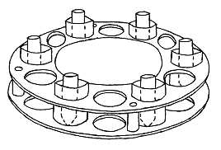
Microwave- assisted Cloud Point Extraction
MW
SPE
CPE
ASDI
MNPs
Prevention
Atom Economy
Dissolution of the surfactant-rich phase
Heating
above CP
sedimentation
Water phase separation
Less Hazardous
Chemical
Designing Safer
Chemicals
Safer Solvents
Energy
Efficiency
Renewable
Feedstocks
Reduce
Derivatives
complexes Inclusion ( ) into the micelles
Surfactant-rich
phase
SRP – diluted to 2.5 g
Sample solution metal ion ( )
Catalysis
Design for
Degradation
Real-time
analysis
Accident
Prevention

Slide 9
Microwave- assisted Cloud Point Extraction
MW
SPE
CPE
ASDI
MNPs
Prevention
Atom Economy
Less Hazardous
Chemical
Model solutions
Pt, Pd, Rh
2‑mercaptobenzo
thiazole,
N,N’-diphenylthiourea
ammonium O,O’-diethyldithio
phosphate
ICP-MS
ICP-OES
Urban dust
Pt, Pd, Rh
2‑mercapto
benzo
thiazole,
ICP-MS
ICP-OES
Laprilen,
Tritace,
Vivace
Enalapril
Pt, Pd, Rh
2‑mercapto
benzo
thiazole,
ICP-MS
Designing Safer
Chemicals
Safer Solvents
Energy
Efficiency
Renewable
Feedstocks
Reduce
Derivatives
Catalysis
Design for
Degradation
Real-time
analysis
Accident
Prevention

Slide 10
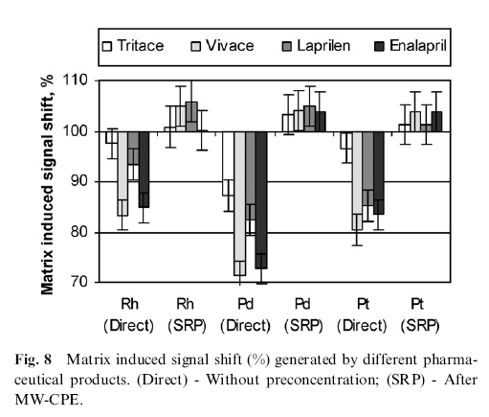
Microwave- assisted Cloud Point Extraction
MW
SPE
CPE
ASDI
MNPs
Prevention
Atom Economy
Less Hazardous
Chemical
Designing Safer
Chemicals
Safer Solvents
Energy
Efficiency
Renewable
Feedstocks
Reduce
Derivatives
Catalysis
For the first time CPE is performed with a MW
It incorporates non-hazardous surfactant
It uses a high efficiency MW energy source that reduces 8 times the incubation time
Design for
Degradation
Real-time
analysis
Accident
Prevention

Slide 11
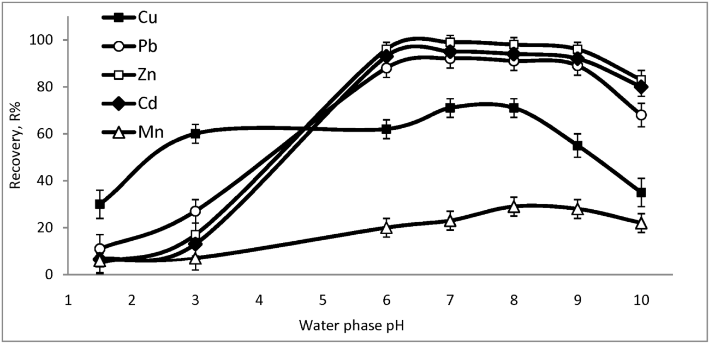
Microwave- assisted Cloud Point Extraction and Air Segmented Discreet Introduction FAAS
MW
SPE
CPE
ASDI
MNPs
Prevention
Atom Economy
Figure 1. Effect of water phase pH on the analyte recovery. Conditions: 2% TX-100; 500:1 molar APDC excess; hot plate incubation for 45 min at 80 ⁰C.
Less Hazardous
Chemical
Vitamins
Zn, Cu, Pb and Cd
APDC
ASDI FAAS
Designing Safer
Chemicals
Safer Solvents
Energy
Efficiency
Renewable
Feedstocks
Reduce
Derivatives
Catalysis
Design for
Degradation
Real-time
analysis
Accident
Prevention

Slide 12
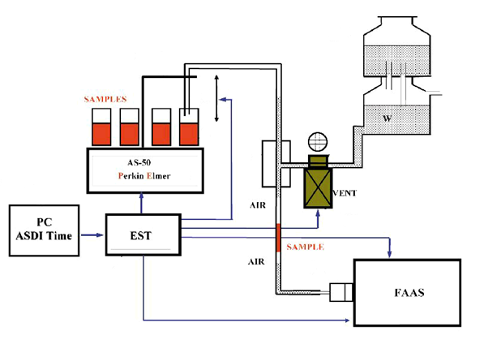
Microwave- assisted Cloud Point Extraction and Air Segmented Discreet Introduction FAAS
MW
SPE
CPE
ASDI
MNPs
Prevention
Atom Economy
Less Hazardous
Chemical
Vitamins
Zn, Cu, Pb and Cd
APDC
ASDI FAAS
Designing Safer
Chemicals
Safer Solvents
Energy
Efficiency
Renewable
Feedstocks
Reduce
Derivatives
Catalysis
Design for
Degradation
Real-time
analysis
Accident
Prevention

Slide 13
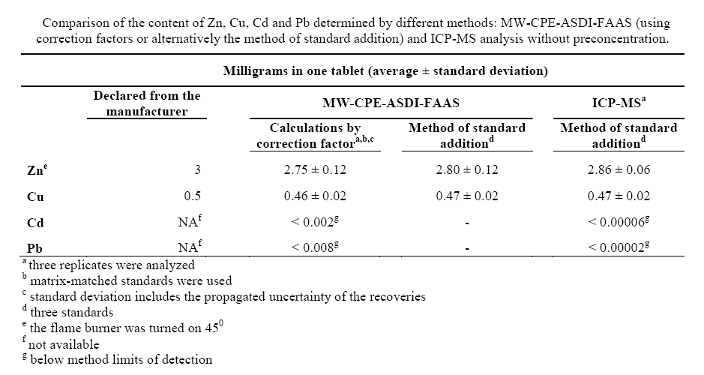
Microwave- assisted Cloud Point Extraction and Air Segmented Discreet Introduction FAAS
MW
SPE
CPE
ASDI
MNPs
Prevention
Atom Economy
Less Hazardous
Chemical
Designing Safer
Chemicals
Safer Solvents
Energy
Efficiency
Renewable
Feedstocks
Reduce
Derivatives
Catalysis
Design for
Degradation
Real-time
analysis
Accident
Prevention

Slide 14
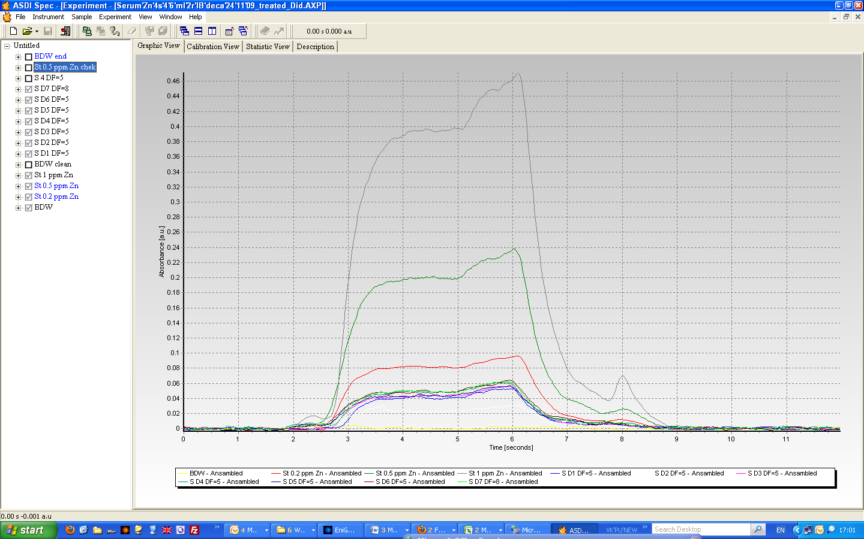
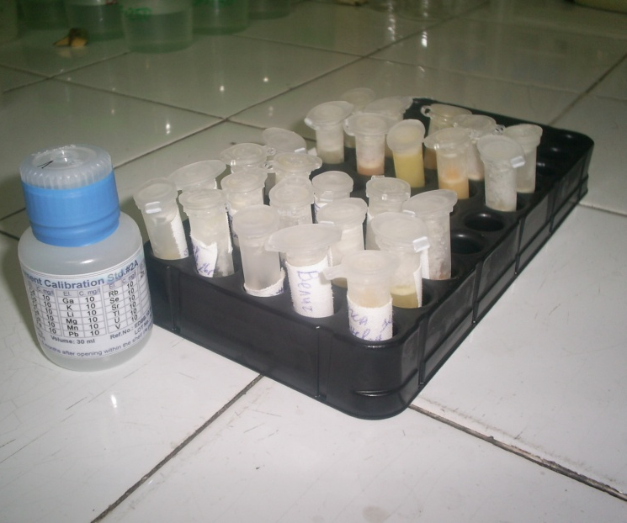
Air Segmented Discreet Introduction FAAS determination of Zn in blood serum
MW
SPE
CPE
ASDI
MNPs
Prevention
Atom Economy
Less Hazardous
Chemical
Designing Safer
Chemicals
Sample volumes from 0.15 – 1 ml (frozen serum )
Dilution factors from 2 - 11
Sample injections from 2- 6 s
Safer Solvents
Energy
Efficiency
Renewable
Feedstocks
Reduce
Derivatives
Catalysis
Design for
Degradation
Real-time
analysis
Accident
Prevention

Slide 15
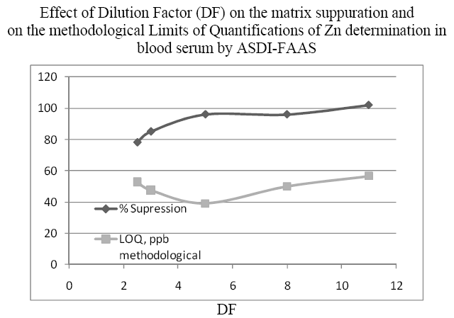
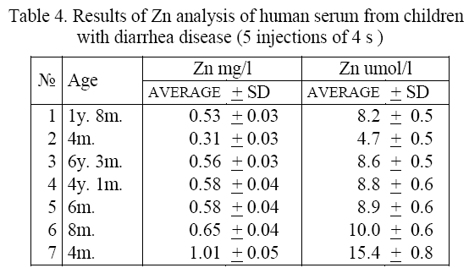
Air Segmented Discreet Introduction FAAS determination of Zn in blood serum
MW
SPE
CPE
ASDI
MNPs
Prevention
Atom Economy
Less Hazardous
Chemical
Designing Safer
Chemicals
Safer Solvents
Energy
Efficiency
Renewable
Feedstocks
Reduce
Derivatives
Catalysis
Low sample consumption
Low dilution factors and methodological LOQ
Higher sample throughput and measurement automation
Design for
Degradation
Real-time
analysis
Accident
Prevention
Notes:
ОТЧЕТ за извършената работа, по проект № D002-336/2008, на тема:
“Оценка на цинковия статус на деца в ранна възраст с остра диария и ефективност на допълнителната терапия с цинк”
С ръководител доц. д.м Марина Ненова
от МЕДИЦИНСКИ УНИВЕРСИТЕТ „Д-Р ПАРАСКЕВ СТОЯНОВ” Варна

Slide 16
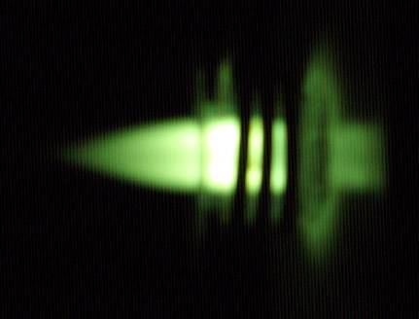
Solid Phase Extraction by Magnetic Nanoparticles
MW
SPE
CPE
ASDI
MNPs
Prevention
Atom Economy
Less Hazardous
Chemical
Designing Safer
Chemicals
5min for MnFe₂O₄ and 10 min for Fe₃O₄
Magnet
continuously mixing
Safer Solvents
2% APDC
Model solution
5 min contact
Phase separation
Energy
Efficiency
MNPs
(Fe₃O₄ and MnFe₂O₄),
0.01 g
Dissolution of MNPs
HNO₃ 0.5 ml
5 mol l⁻¹ on water bath
15 min.
Renewable
Feedstocks
E%
ICP-MS Agilent 7700
Reduce
Derivatives
Catalysis
R%
Design for
Degradation
ICP-OES Optima 4200 Perkin Elmer
Real-time
analysis
Accident
Prevention

Slide 17
Solid Phase Extraction by Magnetic Nanoparticles
MW
SPE
CPE
ASDI
MNPs
Prevention
Atom Economy
Less Hazardous
Chemical
Designing Safer
Chemicals
Safer Solvents
Energy
Efficiency
Renewable
Feedstocks
Reduce
Derivatives
Catalysis
Design for
Degradation
Real-time
analysis
Accident
Prevention

Slide 18
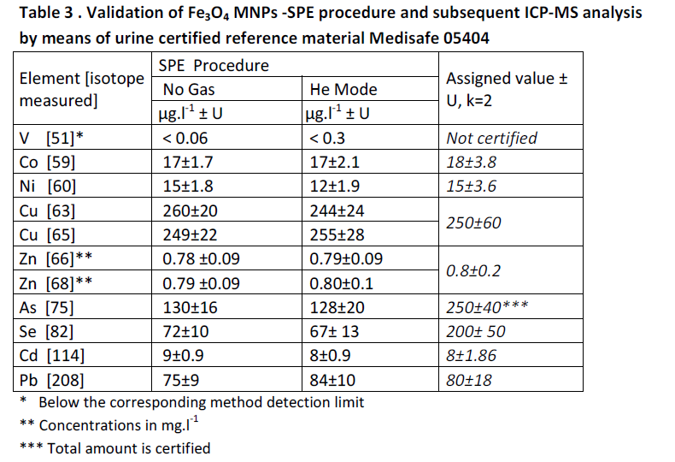
Solid Phase Extraction by Magnetic Nanoparticles
MW
SPE
CPE
ASDI
MNPs
Prevention
Atom Economy
Less Hazardous
Chemical
Designing Safer
Chemicals
Safer Solvents
Energy
Efficiency
Renewable
Feedstocks
Reduce
Derivatives
Catalysis
Simple synthesis of MNPs
Small amount of sorbent phase and good compatibility with ICP-MS
Method effective for a group separation/preconcentration
Design for
Degradation
Real-time
analysis
Accident
Prevention
Notes:
Lyophilized CRM Medisafe was treated accordingly recommended by the manufacturer procedure. Then the
CRM solution was spiked with HNO3 (to 10 %v/v) and subjected to MW treatment for 15 min at 600W.
As prepared CRM solution and urine samples were subjected to SPE procedure (see section 2.4). For the SPE
procedure two calibration strategies were compared: i) the method of Standard addition where two spikes
(with final concentrations 4 μg.l-1and 8 μg.l-1 for V, Co, Ni, Cu, Cd, Pb and 40 μg.l-1and 80μg.l-1 for Zn, As, Se)
were added to the sample aliquot before SPE (Urine SPE StAdd) and ii) Calibration standards were subjected to
the same SPE procedure (Urine SPE calib).
The real urine samples were centrifuged at 4000 rpm for 5 min prior analysis. To 50ml of every urine sample
8ml HNO3 (65%) were added and the solution was subjected to MW treatment for 15 min at 600W. Then the
urine sample was transferred to a volumetric flask and diluted up to 100ml. Blank samples were prepared as
well. For direct ICP-MS analysis the urine samples were additionally diluted (to final DF=10).
The method of Standard addition (StAdd) was applied for correction of non-spectral matrix interferences. Two
spikes from multi-elemental standard solution were added to every urine sample in order to obtain the
concentrations of the spiked analytes as follows: 4 μg.l-1and 8 μg.l-1 for V, Co, Ni, Cu, Cd, Pb; 40 μg.l-1 and
80μg.l-1 for Zn, As, Se.

Slide 19


Acknowledgement to
GAMA project DO 02-70, financed by NSF of Bulgaria
MW
SPE
CPE
ASDI
MNPs
Prevention
Atom Economy
Less Hazardous
Chemical
Designing Safer
Chemicals
Safer Solvents
Thanks
for your attention !
Energy
Efficiency
Renewable
Feedstocks
Reduce
Derivatives
Catalysis
Design for
Degradation
Real-time
analysis
Accident
Prevention

Slide 20
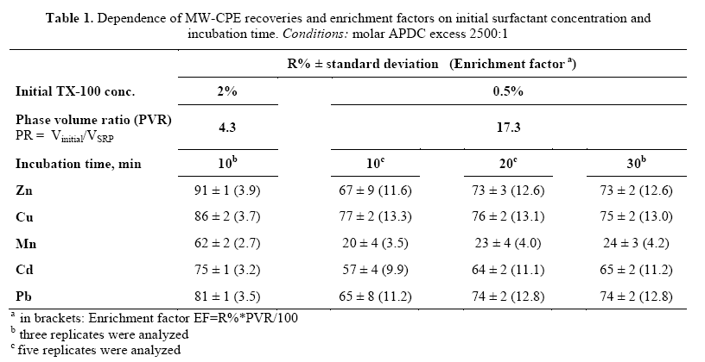
Microwave- assisted Cloud Point Extraction and Air Segmented Discreet Introduction FAAS
MW
SPE
CPE
ASDI
MNPs
Prevention
Atom Economy
Less Hazardous
Chemical
Designing Safer
Chemicals
Safer Solvents
Energy
Efficiency
Renewable
Feedstocks
Reduce
Derivatives
Catalysis
Design for
Degradation
Real-time
analysis
Accident
Prevention

Slide 21
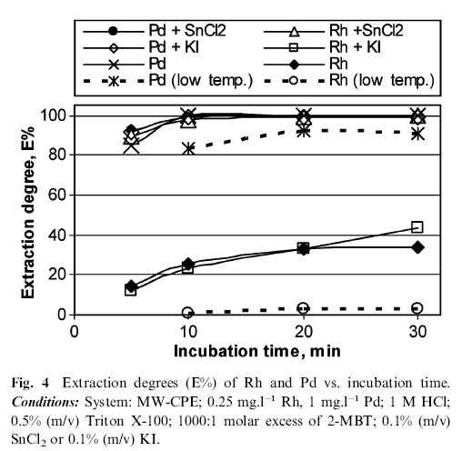
Microwave- assisted Cloud Point Extraction
MW
SPE
CPE
ASDI
MNPs
Prevention
Atom Economy
Less Hazardous
Chemical
Designing Safer
Chemicals
Safer Solvents
Energy
Efficiency
Renewable
Feedstocks
Reduce
Derivatives
Catalysis
Design for
Degradation
Real-time
analysis
Accident
Prevention

